Slide 1
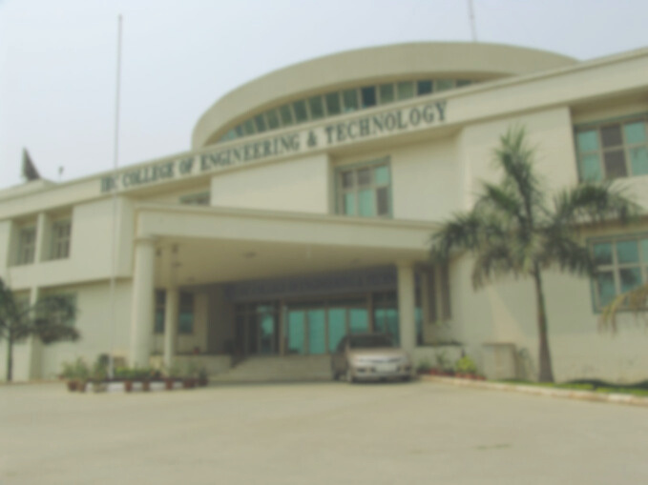





PRESENTATION REPORT ON
MINI PROJECT
(Bouncing Ball Game)
th
SEMESTER : 7
COURSE : B.TECH
BRANCH : CSE
SUBMITTED TO :
SUBMITTED BY :
Ms. Shahina Anjum
Prajjawal Kumar
Ms. Arushi Gupta
(2200900100100)

Slide 2
INTRODUCTION
The Bouncing Ball Game is a mini-project developed using Python and the PyGame library, aimed at demonstrating the fundamentals of 2D game development. The game revolves around a ball that continuously bounces within the game window, while the player interacts with it to maximize their score.
Key features of the game include:
High Score System – records and displays the best score achieved across multiple sessions.
Restart and Quit Options – enabling players to restart the game instantly or exit smoothly.
Background Music – provides an engaging environment during gameplay.
Sound Effects – triggered during ball bounces, scoring, and game-over events for a realistic feel.
The project highlights essential programming concepts such as event handling, collision detection, loops, functions, and file handling (for score storage). Additionally, the integration of multimedia through PyGame enhances the gaming experience with visual and audio effects.
Overall, this project demonstrates the practical use of Python programming for creating simple yet interactive games, making it a valuable exercise in understanding game mechanics, logic building, and multimedia handling.

Slide 3
OBJECTIVE
The main objectives of developing the Bouncing Ball Game are:
To learn and apply Python programming concepts such as loops, functions, event handling, and conditional statements in a practical project.
To gain hands-on experience with the PyGame library, which is widely used for 2D game development in Python.
To implement core game development concepts like collision detection, motion, scoring system, and user input handling.
To enhance the user experience by integrating background music and sound effects for different in-game events.
To design a simple but interactive interface with options such as restart, quit, and high score tracking.
To develop problem-solving and logical thinking skills through the process of building and debugging the game.

Slide 4
MOTIVATION/RELEVANCE
The motivation behind developing the Bouncing Ball Game lies in the desire to combine fun with learning. Game development is one of the most engaging ways to strengthen programming skills because it requires logical thinking, creativity, and real-time problem-solving. By choosing Python and PyGame, the project makes use of a beginner-friendly yet powerful toolset for creating interactive applications.
This project is relevant because:
Educational Value – It provides a practical way to apply programming concepts beyond theoretical learning.
Skill Development – Working with PyGame helps in understanding event-driven programming, graphics handling, and multimedia integration.
Entertainment Factor – The game serves as a fun application that can be enjoyed by players while also being simple enough to understand.
Foundation for Advanced Projects – This mini-project can act as a stepping stone for developing more complex games in the future.

Slide 5
TOOLS AND TECHNOLOGIES
Programming Language: Python
Python was chosen due to its simplicity, readability, and strong support for beginners as well as advanced developers.
Game Development Library: PyGame
PyGame is a cross-platform Python library designed for writing 2D games.
It provides functionality for graphics, sound, event handling, and collision detection, making it ideal for small game projects.
Integrated Development Environment (IDE):
VS Code for writing, debugging, and running the code.
Audio and Visual Assets:
Background music and sound effects were added to improve the gaming experience, and simple graphics for the background was used.
Operating System:
The project was developed and tested on Windows, but it can run on any OS that supports Python and PyGame.

Slide 6
SYSTEM REQUIREMENTS
Hardware Requirements
Processor: Intel/AMD Dual Core or higher
RAM: Minimum 2 GB (4 GB recommended)
Storage: At least 200 MB free space
Graphics: Basic integrated graphics (sufficient for 2D PyGame applications)
Input Devices: Keyboard and Mouse
Software Requirements
Operating System: Windows / Linux / macOS (any OS supporting Python and PyGame)
Programming Language: Python 3.x
Libraries: PyGame (installed via pip install PyGame)
IDE/Editor: VS Code / PyCharm / IDLE (or any preferred Python IDE)
Audio Support: Required for background music and sound effects

Slide 7
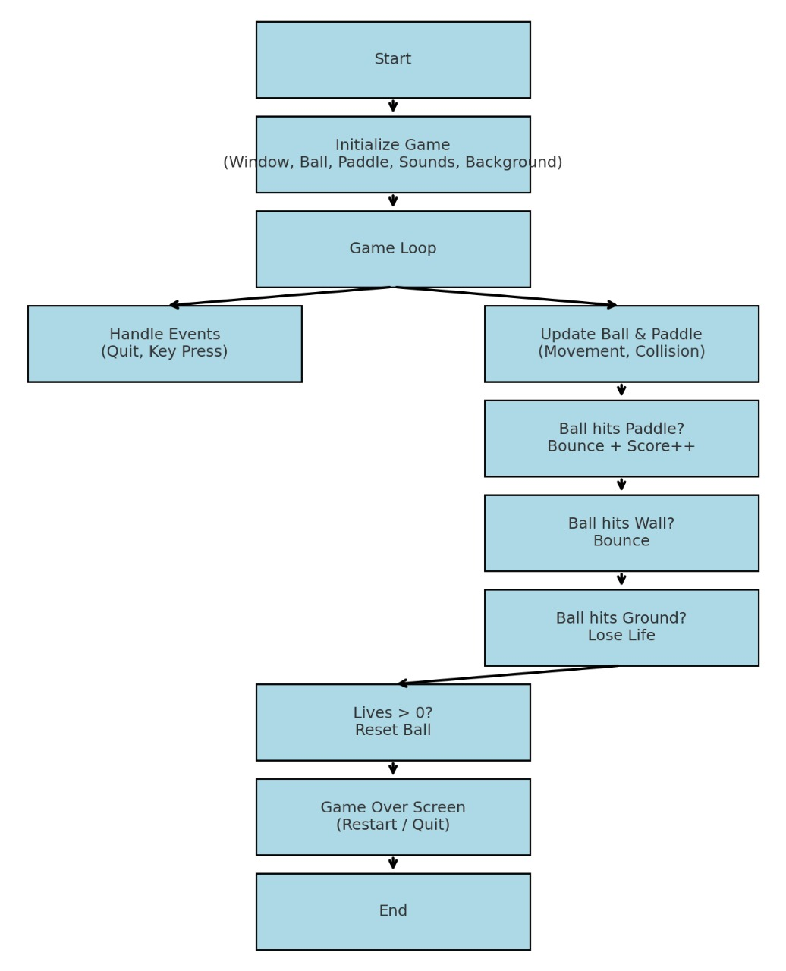
FLOWCHART

Slide 8
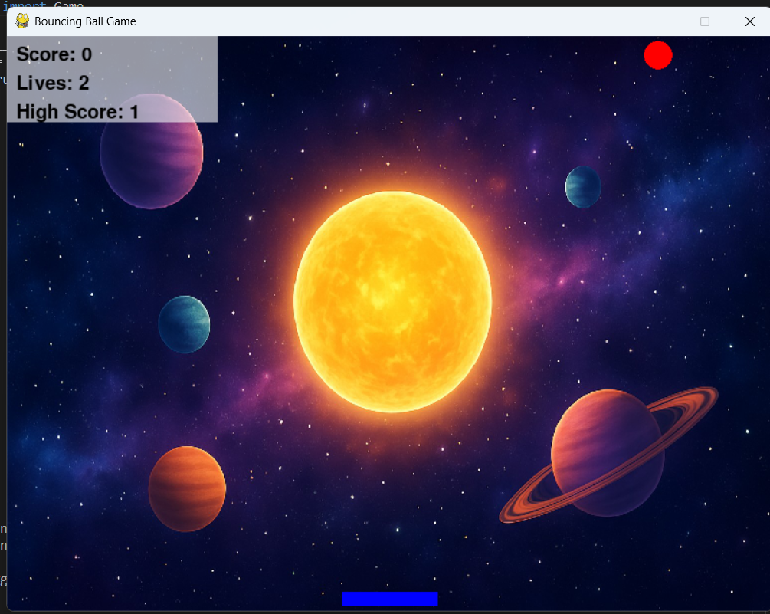
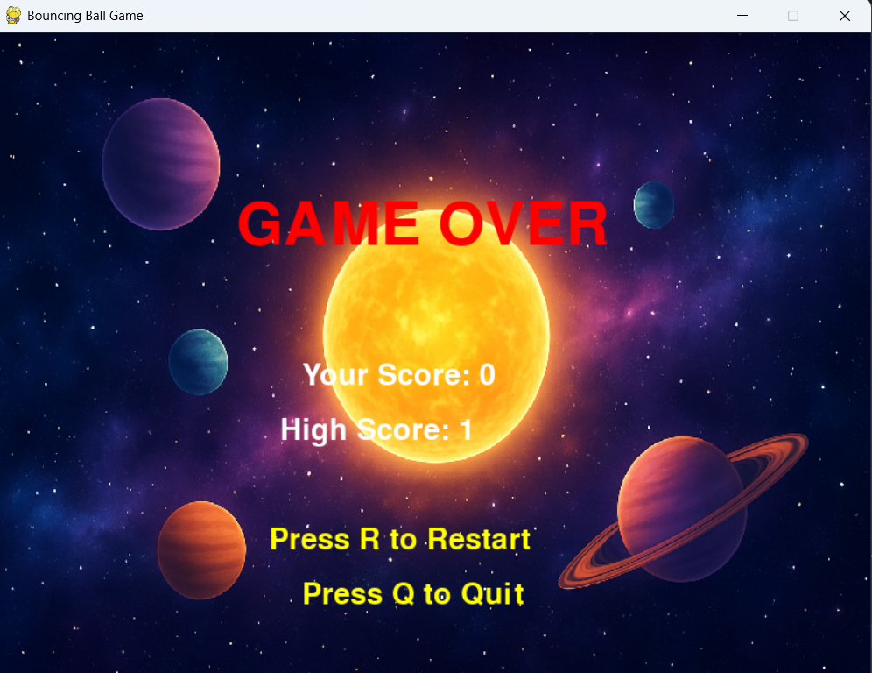
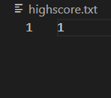
SCREENSHORTS

Slide 9
CHALLENGES FACED
Handling collision detection (ball ↔ paddle & walls)
Preventing paddle from crossing screen boundaries
Resetting ball position after life lost
Implementing gradual speed increase smoothly
Adding background image and scaling it properly
Managing multiple sound effects without lag
Designing restart & quit options in Game Over screen

Slide 10
RESULTS AND ACHIEVEMENTS
Successfully bult playable game.
Applied programming concepts.
Gained practical experience in game development.
Implemented lives system , high score , restart & quit options
Integrated graphics , sound , and UI controls
Improved skills in Python, game loops, and collision detection
Built a foundation for adding advanced features (levels, power-ups, etc.)

Slide 11
FUTURE ENHANCEMENTS
Difficulty Levels – increase ball speed or reduce paddle size as score rises
Power-ups & Power-downs – extra life, bigger paddle, slow/fast ball
Multiple Balls – add more balls for advanced gameplay
Brick/Target System – evolve it into a Breakout/Arkanoid-style game
Pause & Settings Menu – sound on/off, difficulty selection
Save Progress – permanent high score storage and player profiles
Improved Graphics & Animations – particle effects, level-based backgrounds
Packaging – convert into executable (.exe) for easy sharing

Slide 12
CONCLUSIONS
Successfully developed an interactive Bouncing Ball Game using Python
Implemented key features: lives, high score, restart/quit, sounds, background
Enhanced understanding of game loops, collision detection, and UI design
Project demonstrates problem-solving, creativity and programming skills
Provide a strong base for future upgrades like levels, power-ups, and brick-breaking gameplay

Slide 13
THANK YOU

